Slide 1
IoTeye Inc.
Employee Engagement & Recognition Platform
Proposal for The Arc Mercer
April 2026 | Basking Ridge, NJ | www.ioteyeinc.com

Slide 2
Agenda
1. About IoTeye & Platform Ecosystem
2. BrainClaw AI Agents — Already at Arc Mercer
3. Understanding Your Challenge
4. Platform Overview & Architecture
5. Key Features (Nominations → Engagement → Marketplace)
6. Integration, Authentication & Accessibility
7. Dashboards — Employee & Leadership
8. Implementation Timeline & Pricing
9. Feature Comparison — How We Stack Up
10. Why IoTeye — Next Steps

Slide 3
About IoTeye Inc.
Who We Are
Our Products
• Remote software company — Basking Ridge, NJ
• 5+ years building special care software
• 1,000+ consumers across our platforms
• Core domain: Special Care sector
• Full-stack SaaS expertise: design → deploy → support
• SpringBoard: Multi-agency route management & operations (route opt., fleet, Twilio SMS, multi-tenant)
• BrainBook: AI platform — Next.js/React/TypeScript, Supabase, AI agents, voice I/O, desktop & web
• Guardian: Notification & authentication system — SMS, push notifications, reply tracking, iOS & Android
• BrainClaw: AI agent gateway (GPT-4.1) — 37-tool SpringBoard agent & 57-tool Samsara agent live at Arc Mercer

Slide 4
Total Agency Services for Special Care
Special Care Cloud (AWS)
Platform Products
• Market: 6,000+ special care agencies in the USA
• Agentic AI Platform — Cloud, Desktop, Mobile, IoT
• Personal AI assistants for agency workflows
• Apps for Parent/Guardian, Consumer/Patient, Staff/Driver
• IoT: OBD, DashCam, Minew Proximity, Home Assistant Green
• Samsara App Partner — fleet telematics
• HIPAA-compliant AI inference servers
SpringBoard
Route/Fleet — paratransit ops, multi-tenant
Guardian
Notifications & authentication — SMS, push, reply tracking
BrainBook
AI Platform — desktop, web, mobile, voice I/O
BrainClaw
AI Agents — 94+ tools, Microsoft GitHub Copilot, Arc Mercer live

Slide 5
BrainClaw AI Agents — Already at Arc Mercer
In Production at Arc Mercer Today
Extending to Recognition Platform
Powered by BrainClaw + Microsoft GitHub Copilot
Natural language for HR & leadership:
• SpringBoard Agent — 37 tools
• Routes, fleet, consumers, optimization, SMS, GPS, SOS
• Samsara Agent — 57 tools
• Vehicles, drivers, HOS, safety events, DVIRs, GPS
• "Which program had most nominations last month?"
• "Who hasn't been recognized in 60+ days?"
• "Flag unusual point bestowals this week"
• "Generate Q1 engagement report as CSV"
• "What's our engagement score this month?"
Arc Mercer staff use natural language today:
"Optimize routes for Weekday AM" "Where is vehicle 147 right now?" "SMS all Residential drivers — 10 min delay" "Generate daily manifest for Arc Mercer"
★ Optional add-on — same BrainBook UI Arc Mercer already uses

Slide 6
Understanding Your Challenge
The Arc Mercer's Current State
What You Need
• Manual recognition processes — inconsistent, hard to track
• Multiple programs (Residential, Day Programs) operating in silos
• Frontline staff with varying technical literacy
• Many frontline DSPs lack company email addresses
• Selection committee uses ranked-choice voting — no digital tool
• No centralized system for nominations or point tracking
• No connection to Paycom HRIS for employee data
• Centralized, web-based recognition platform
• Program-based competition engine with committee voting
• Multi-stream point system with audit trails
• Rewards marketplace — digital, café, and in-person store
• Paycom integration & flexible auth (SSO + Badge ID + PIN)
• Community engagement: TAC, culture groups, volunteering
• Mobile-first, accessible to all staff (incl. dark mode)

Slide 7
Our Solution — Platform Overview
Custom-Built SaaS — Tailored for The Arc Mercer
React + TypeScript PWA
Mobile-first responsive design, offline capable
Supabase (PostgreSQL)
Auth, real-time subscriptions, Row Level Security
Python (FastAPI)
Paycom SFTP sync, gift card APIs, scheduled jobs
AWS Cloud
ECS Fargate, CloudFront, S3, WAF, CloudWatch
Security: AES-256 at rest | TLS 1.3 in transit | Full audit logging

Slide 8
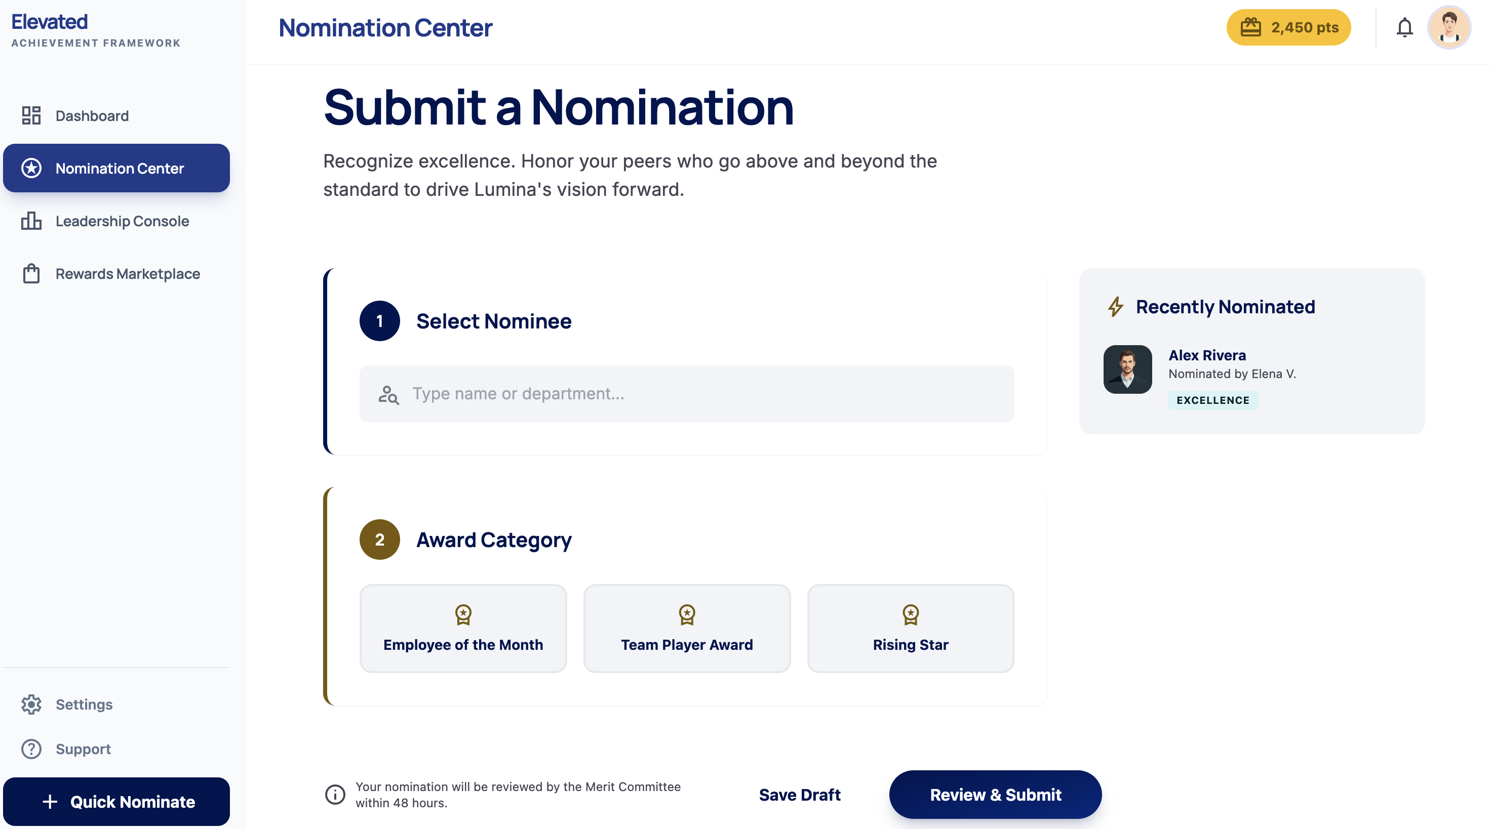
Nominations, Voting & QA Engine
Nominations
• 3 award types: Employee of the Month, Rising Star, Team Impact
• Step-by-step guided form with large buttons
• 1 nomination per candidate/month, 5 total/month
Selection Committee Voting
• Ranked-choice drag-and-drop voting interface
• Private ballots — not visible until window closes
• Automated tally (Borda count / weighted rank)
• Per-voter audit trail & historical ballot archive
QA Queue & Revise-Resubmit
• Approve / Return for Edits / Decline with batch operations
• Formal resubmission loop: status tracking through full cycle
• Admin comments → nominator notification → edit & resubmit

Slide 9
Points, Engagement & Community Modules
Multi-Stream Point Accrual
Community Engagement
Point Stream
Trigger
• TAC RSVP & Role Sign-Ups: RSVP workflow, role selection (setup, check-in, cleanup), automated reminders
• Culture Groups: Self-service directory, one-tap sign-up, attendance tracking, participation points
• Volunteer Forms: Event help board, volunteer slots, completion tracking, engagement score
• Social Media: Screenshot upload, admin review queue, campaign tracking
• Audit & Transparency: Immutable transaction log, anomaly detection, CSV export
Employee / Rising Star / Team Impact (Approved)
QA queue approval
TAC Meeting Attendance
Admin check-in
TAC Meeting Role Completion
Role fulfilled
Culture Group Participation
Leader/admin log
Volunteer / Event Help
Post-event confirmation
Social Media Engagement
Screenshot review
Newsletter Trivia
Correct answer
Birthday / Anniversary
Automated (Paycom)
Leadership Bestowal
Manual award
All point values are admin-configurable — no code changes needed

Slide 10
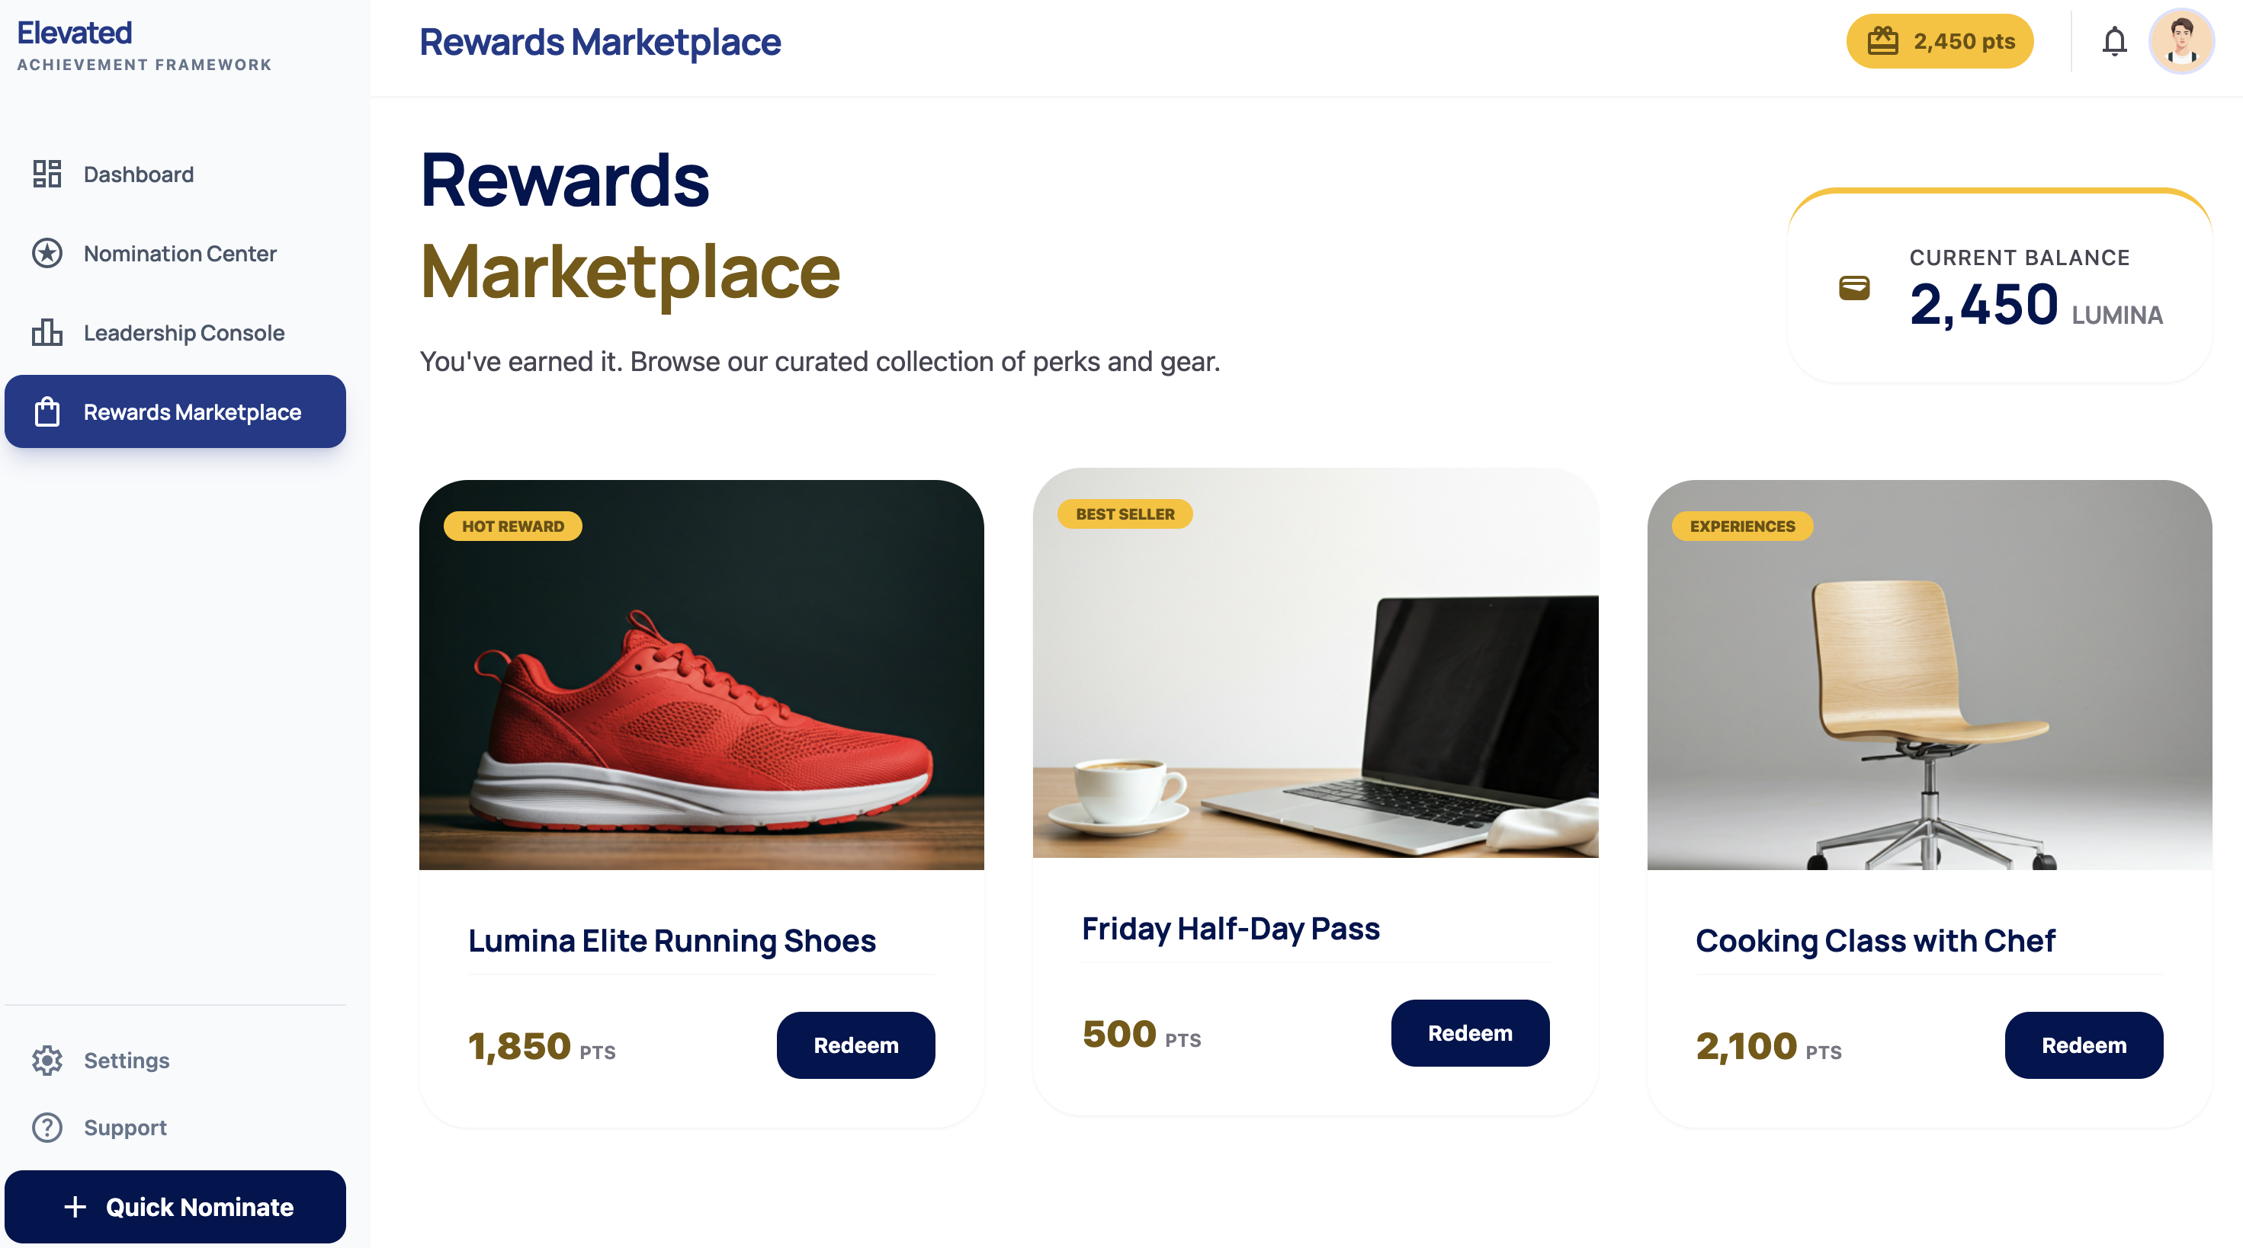
Rewards Marketplace — Digital, Café & In-Person Store
Digital Storefront
• Visual catalog with images, point costs, descriptions
• Categories: Merchandise, Cafeteria Meals, Gift Cards
• Real-time point balance during browsing
• One-tap redemption with confirmation
Café Cashier Redemption Screen
• Tablet-friendly cashier interface for meal redemptions
• Employee lookup by name, badge ID, or QR code
• Balance display → meal selection → point deduction
• No POS integration required — standalone operation
In-Person Store & QR Redemption
• Employee QR code on profile / home screen
• Store attendant scans QR → select item → confirm
• Inventory sync: physical store + digital storefront

Slide 11
Paycom Integration & Authentication
Paycom HRIS Integration
Three Login Paths
• Primary: SFTP nightly file export (CSV/XML)
• Python ETL service parses & syncs to Supabase
• Auto-provision new hires, deactivate terminations
• Sync: Employee ID, name, email, program, hire date, DOB
• Discrepancy reports flagged for HR review
• Optional: REST API enhancement (if subscription supports)
➀ Badge ID + PIN (Frontline Staff)
• Paycom badge ID — the ID they already carry daily
• Self-set 4–6 digit PIN, no email required
• Hashed/salted PINs, lockout after 5 failed attempts
➁ Google Workspace SSO (Admin & Mgmt)
• Supabase Auth: SAML 2.0, OAuth 2.0, OIDC
• Future: Microsoft Entra ID — zero-downtime migration
Paycom → SFTP Export → AWS S3 → Python ETL ↓ Supabase (PostgreSQL) ↓ React Front End (Live Data)
➂ Email / Password Fallback
• For part-time or seasonal staff with email but not on SSO
• Guardian authentication
★ Every employee can access the platform — no matter their tech level or email situation

Slide 12
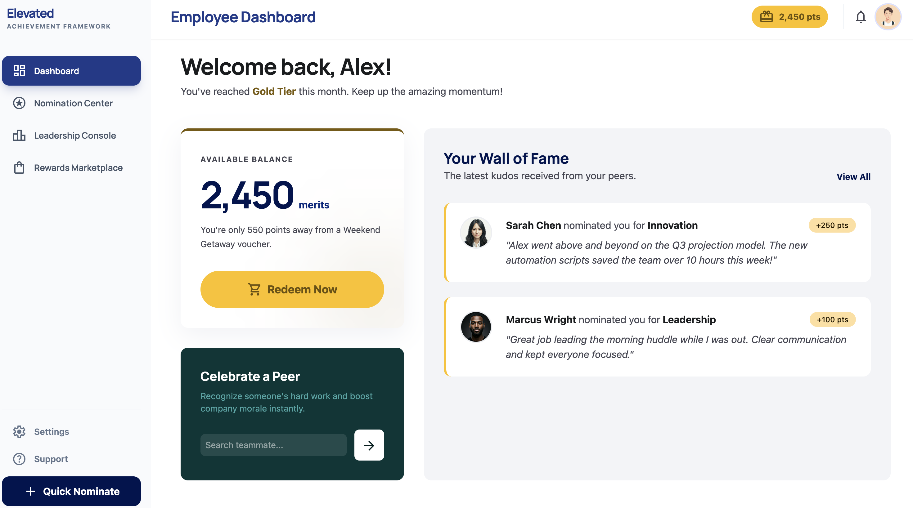
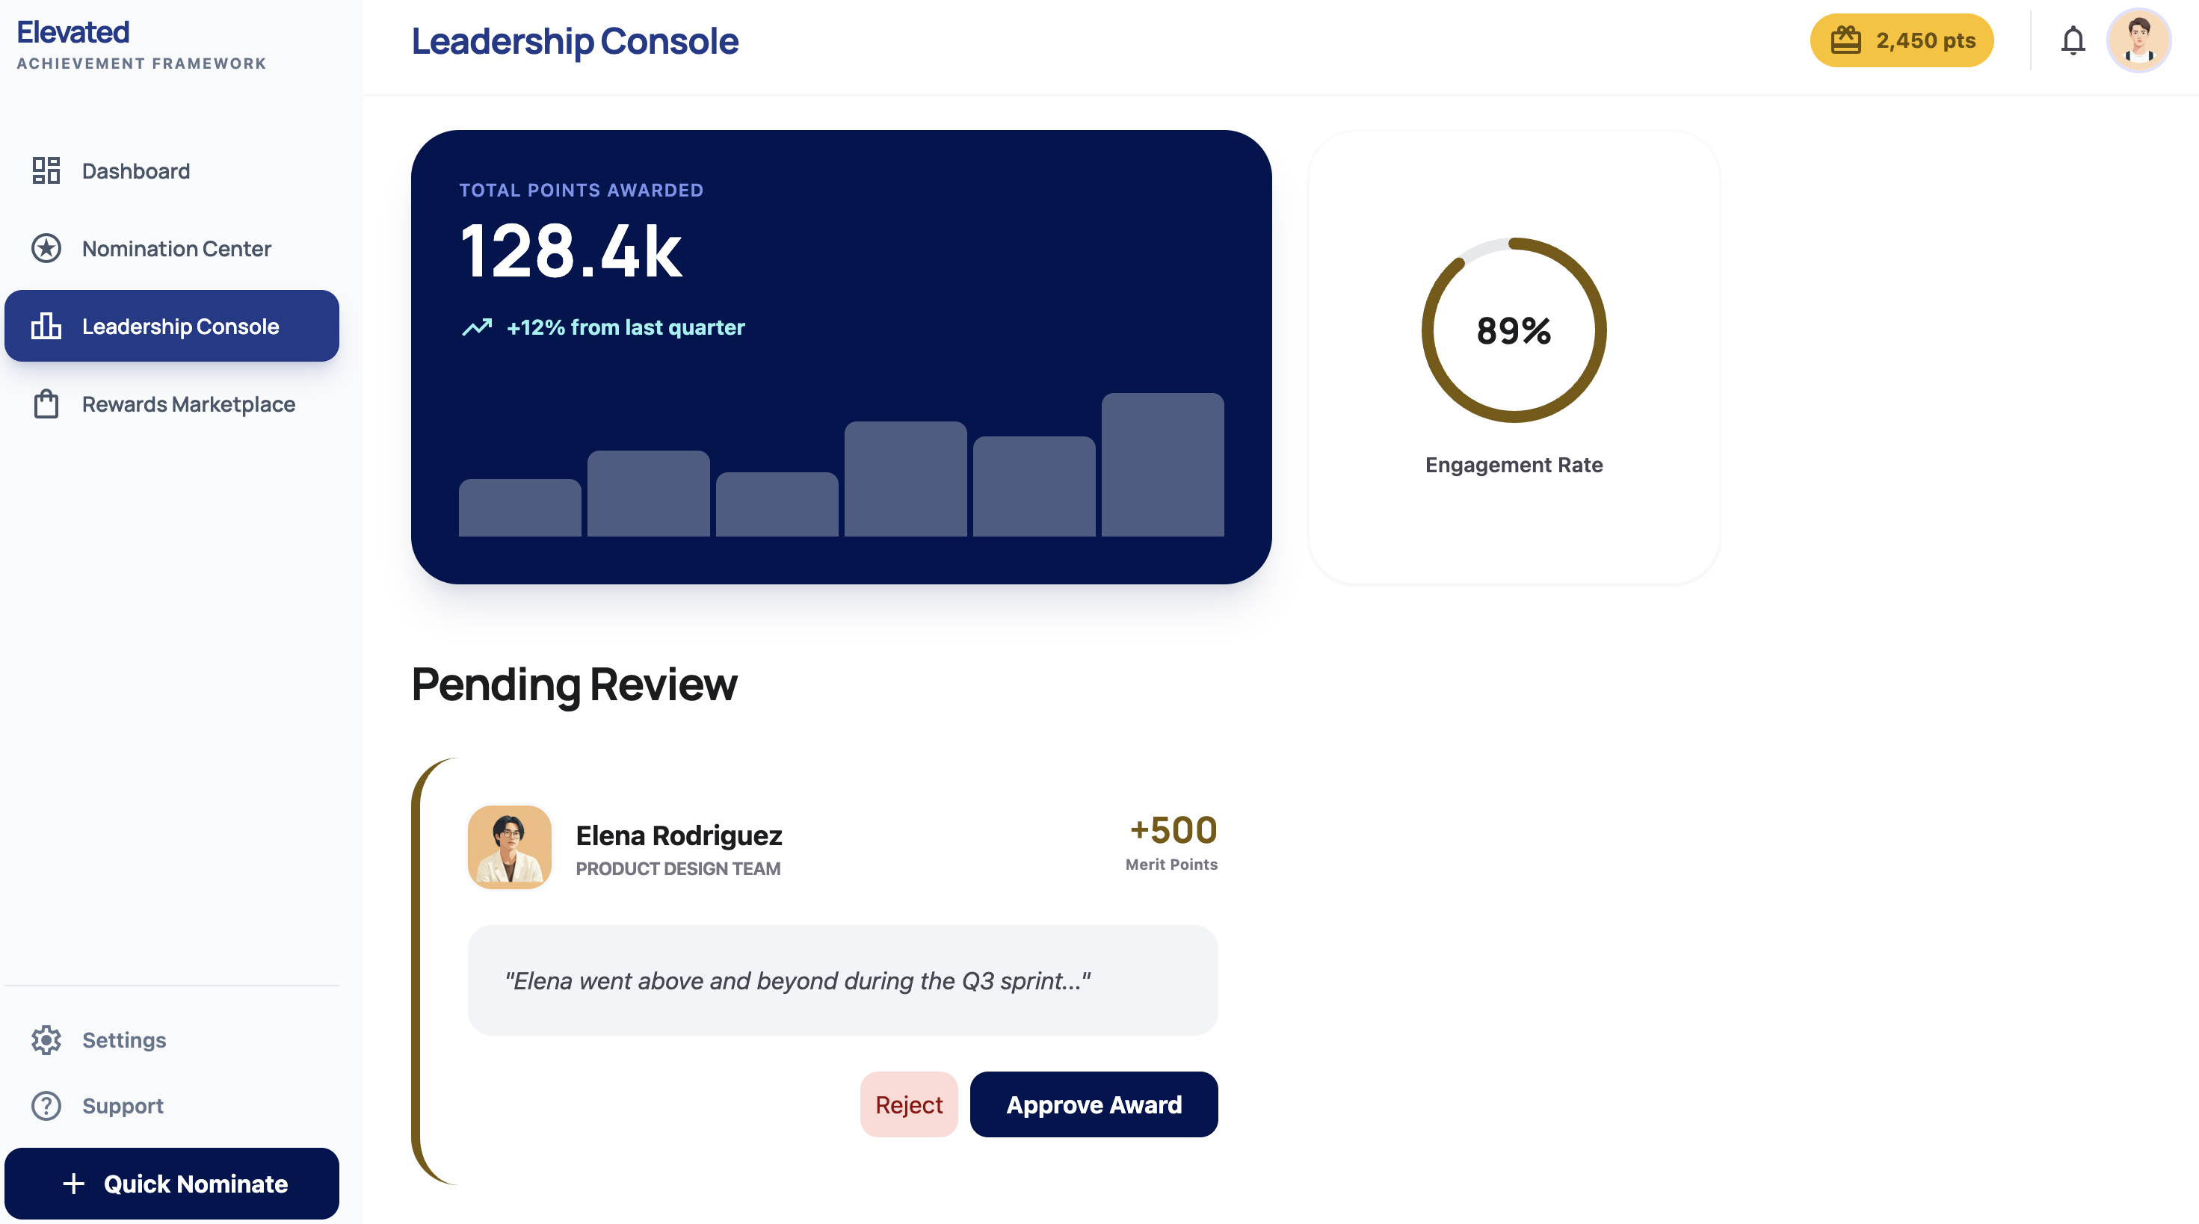
Dashboards — Employee & Leadership
Employee Dashboard
Leadership Console
Points Balance • Wall of Fame • Quick Nominate
Total Points • Engagement Rate • QA Pending Review
All dashboards are real-time • Mobile-first • Accessible on any device • Role-based visibility

Slide 13
Phased Implementation — 36 Weeks
Phase 1: Foundation (Weeks 1–12)
Phase 2: Engagement (Weeks 13–24)
Phase 3: Marketplace (Weeks 25–36)
Phase 1 Deliverables
Phase 2 Deliverables
Phase 3 Deliverables
• Nomination engine + ranked-choice committee voting
• QA queue with revise-and-resubmit workflow
• Paycom SFTP sync + audit trail
• Auth: Badge ID + PIN, Google SSO, email fallback
• Employee & leadership dashboards
• Dark mode / light mode toggle
• TAC RSVP, culture groups, volunteer forms
• Social media engagement (screenshot)
• Push/email notifications
• Digital rewards storefront
• Café cashier redemption screen
• In-person store QR code scanning
• Gift card instant delivery
• Inventory management & fulfillment

Slide 14
Pricing — Option A: Source-Code Ownership
The Arc Mercer owns all source code, database, and IP
Phase
Hours
Cost
Annual Recurring
Phase 1: Nominations, Voting, Paycom, Badge ID Auth, SSO
~480 hrs
$45,000
• AWS hosting/CDN/monitoring: $6,000
• Supabase Pro Plan: $3,000
• SSL & domain: $200
• Maintenance & support: $12,000
• Total annual: $21,200/year
Phase 2: Dashboards, Engagement Modules, Dark Mode, Notifications
~310 hrs
$35,000
Phase 3: Marketplace, Café Redemption, QR Store, Gift Cards
~280 hrs
$30,000
Total Implementation
~1,070 hrs
$110,000
Blended rate: ~$103/hr — well below $150-250/hr industry standard
Year 1 Total: $131,200
Year 2+: $21,200/year
★ AI-assisted add-ons INCLUDED — LLM usage fee only (pass-through) | Custom development available upon request ★

Slide 15
Pricing — Option B (SaaS) & Option C (Shared Ownership)
Option B: IoTeye-Hosted SaaS
Option C: Shared Ownership (Hybrid)
• Implementation fee: $0
• Subscription: $3,000/month ($36,000/year)
• 3-year minimum commitment
• IoTeye retains all source code ownership
• Hosting, maintenance, updates all included
• Implementation fee: $55,000 (50% of full build)
• Annual platform fee: $36,000/year (managed service)
• Arc Mercer & IoTeye share recognition platform code (50/50)
• Excludes: BrainBook, SpringBoard, Guardian, BrainClaw
• Reuse rights deferred to agreement
★ AI-assisted add-ons INCLUDED — LLM usage fee only (pass-through) | Custom development available upon request ★
Option A vs. B vs. C — Cost Comparison
A: Own Code
B: SaaS
C: Shared
Upfront Cost
$110,000
$0
$55,000
Annual Cost
$21,200/yr
$36,000/yr
$36,000/yr
3-Year Total
$173,600
$108,000
$163,000
5-Year Total
$216,000
$180,000
$235,000
Code Ownership
Full
None
50/50 recognition

Slide 16
Feature Comparison — How We Stack Up
37 features evaluated across all 3 proposals submitted for this RFP
Category
IoTeye
Proposal 1
Proposal 2
IoTeye-Exclusive Advantages
Nomination & Recognition (6)
6
5
4
• BrainClaw AI — 94+ tools already in production at Arc Mercer
• Badge ID + PIN login for frontline staff without email
• WCAG AAA accessibility (7:1 contrast, screen reader tested)
• AWS HIPAA-eligible infrastructure, 99.9% uptime SLA
• Severity-based SLAs (Critical: 2hr response)
• Source code ownership option (Option A)
• Multi-IDP SSO migration path (Google → Microsoft)
• Anomaly detection & immutable audit trails
Selection & Voting (3)
3
2
3
Authentication & Access (5)
4
1
1
Engagement & Participation (6)
6
5
2
Rewards & Redemption (5)
5
4
4
Analytics, AI & Reporting (4)
4
2
2
Technical & Infrastructure (8)
8
2
2
TOTAL
36 / 37
21 / 37
18 / 37
★ 36 of 37 features — Magic Link excluded (Badge ID + PIN better serves frontline staff) | 10 features added, all within $110K budget ★

Slide 17
Why IoTeye — Next Steps
Why We're the Right Partner
Next Steps
• 5+ years in special care software — we know your workforce
• Arc Mercer is an existing IoTeye customer (SpringBoard & Guardian)
• BrainClaw AI agents already in trials at Arc Mercer (37+57 tools)
• In-house Paycom & Guardian integration experience at Arc Mercer, not a cold start
• Three flexible pricing options: full ownership, SaaS, or Shared Partner (50/50)
• AI-assisted add-ons FREE — pay only AI LLM usage (pass-through)
• Select pricing option (A, B, or C)
• Schedule kickoff & discovery workshop
• Initiate Paycom SFTP access setup
• Configure Google Workspace SSO + Badge ID mapping
• Phase One live in 12 weeks
Contact Us
IoTeye Inc. Basking Ridge, New Jersey mingjye.sheng@ioteyeinc.com www.ioteyeinc.com
Thank You

